Slide 1

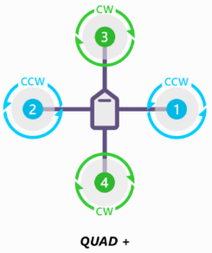
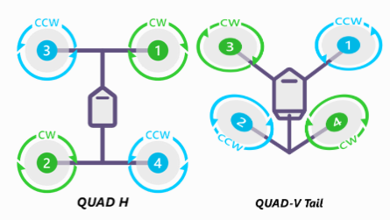
https://ardupilot.org/copter/docs/connect-escs-and-motors.html

Slide 2
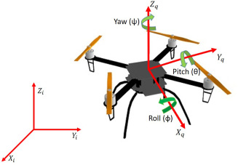
https://www.sciencedirect.com/science/article/abs/pii/S0921889022002317

Slide 3
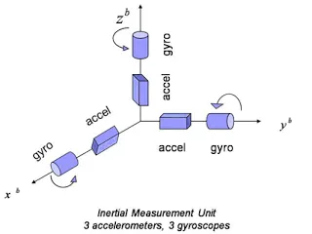
https://i1.wp.com/bestperformancegroup.com/wp-content/uploads/2012/05/Fig_5.jpg

Slide 4
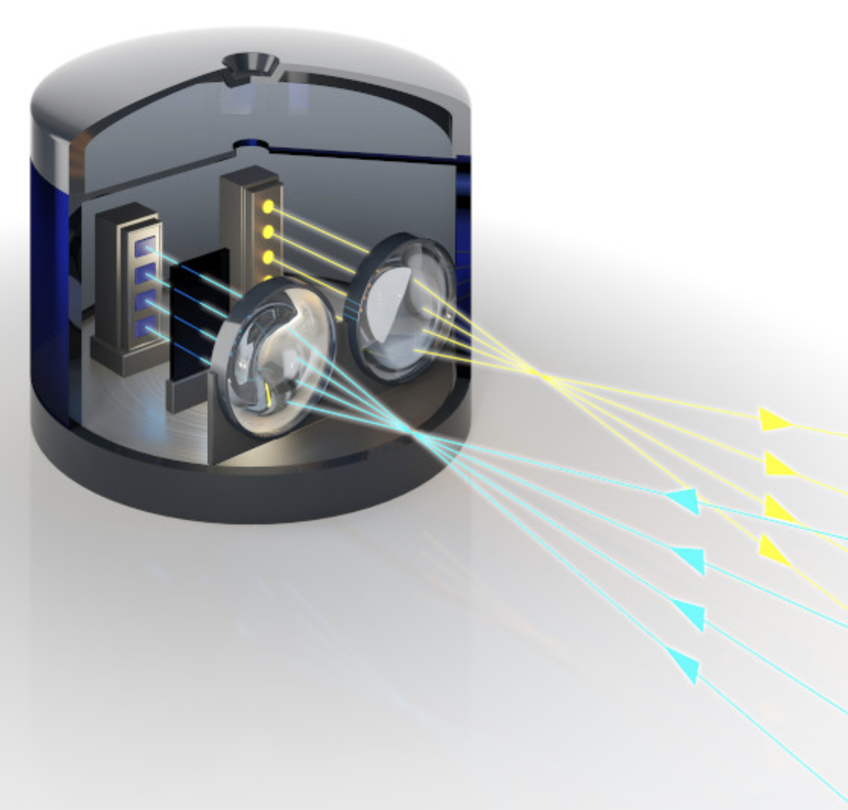
https://www.schott.com/en-th/products/hermetic-packages-for-lidar-sensors-p1000281/applications

Slide 5
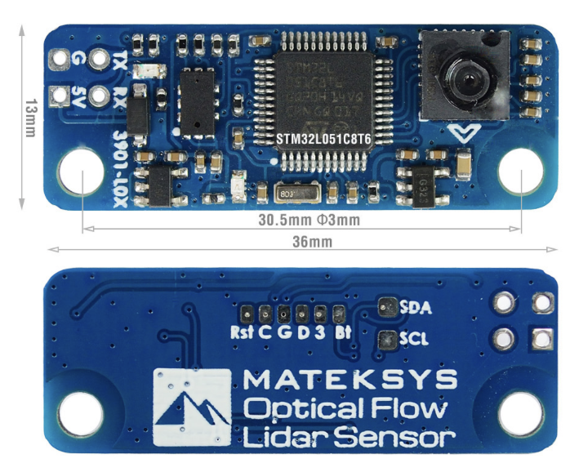
https://www.mateksys.com/?portfolio=3901-l0x

Slide 6
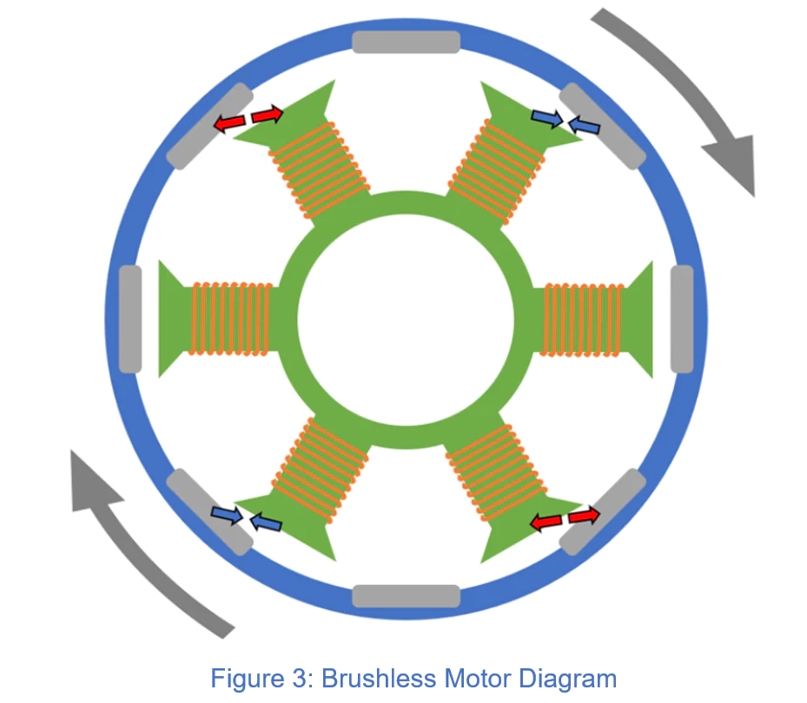
https://www.tytorobotics.com/blogs/articles/how-brushless-motors-work

Slide 7
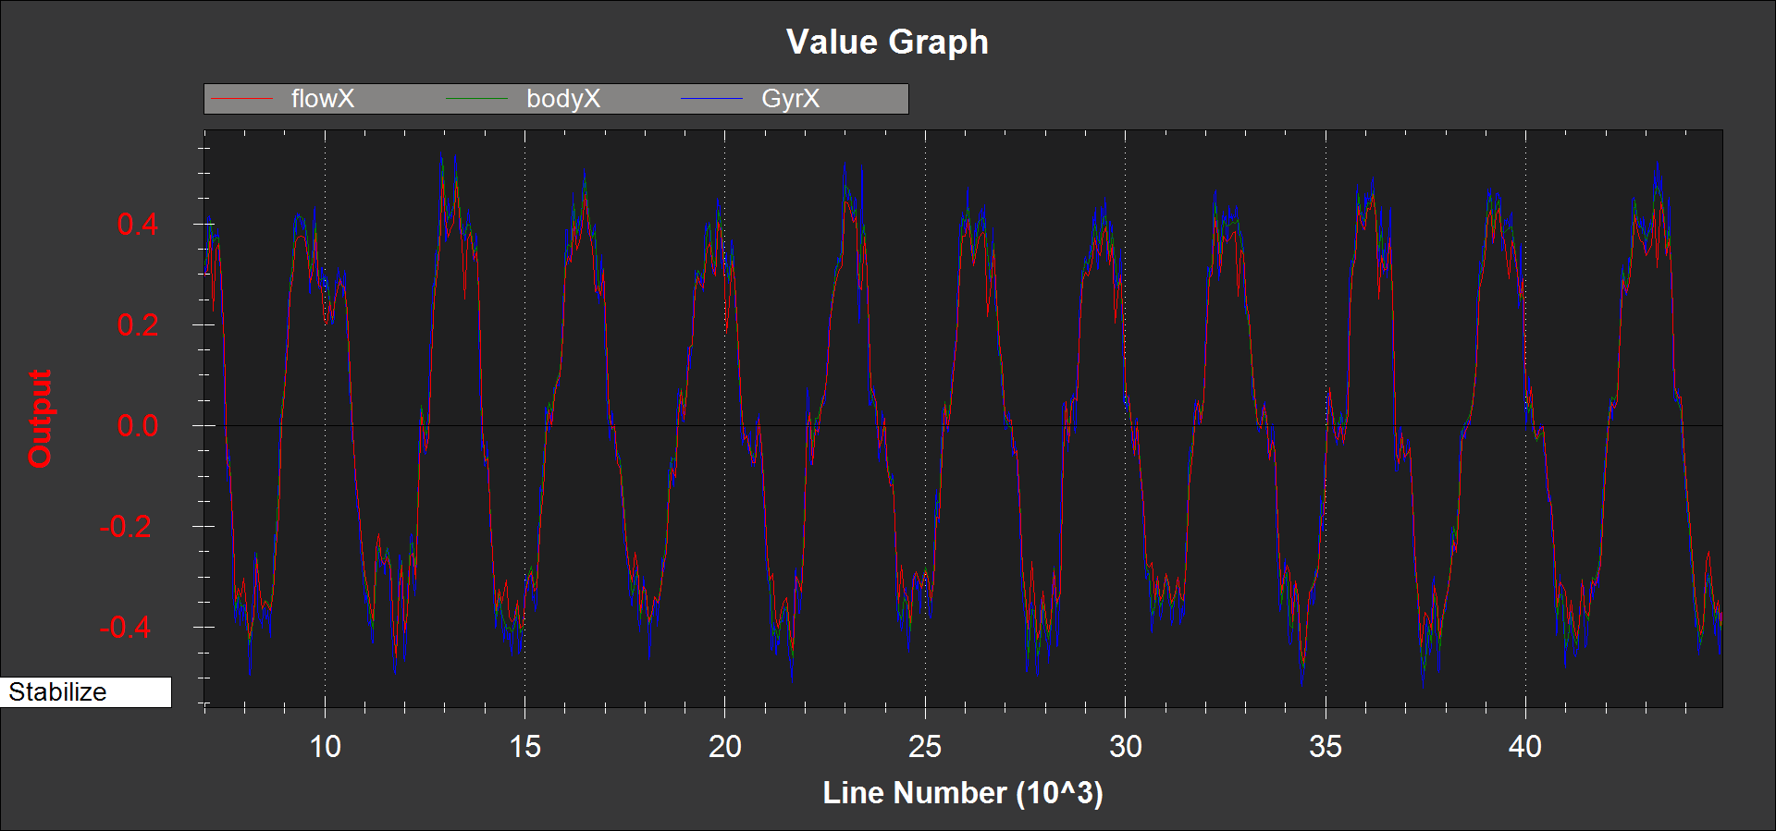
https://ardupilot.org/copter/docs/common-optical-flow-sensor-setup.html

Slide 8
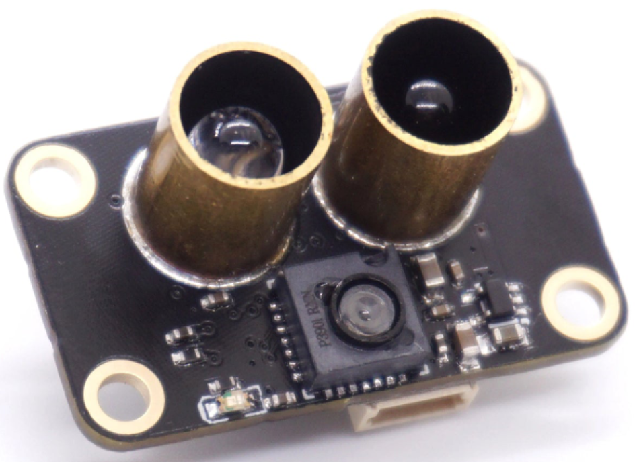
https://robofusion.net/products/mtf-01-integrated-laser-rangefinder-optical-flow-module-for-unmanned-aerial-vehicles-uavs

Slide 9
